Slide 1
Burrows-Wheeler Transform and FM Index
Needleman-Wunsch algorithm
Filip Tanić 2020/3135
Maja Skoko 2020/3126

Slide 2
Task summary
1. Implementing Burrows-Wheeler Transformation and FM index
2. Algorithm for global alignment aka Needleman-Wunsch algorithm
3. Input files format: .fasta, .fastq
Using “Seed and Extend” method
4. Comparing results with BWA MEM tool and presenting results graphically and tabularly

Slide 3
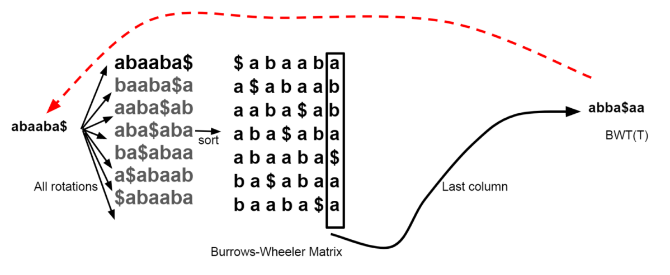
Burrows-Wheel Transformation
rearranges a string into runs of similar character
useful for compression
the transformation is reversible
BWT + FM index is off-line exact string matching algorithm

Slide 4
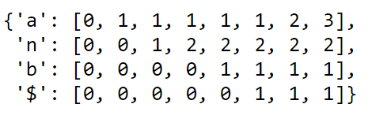
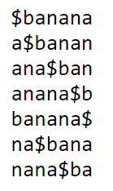

FM index
C contains the number of occurrences of characters in the text
Occ(c, k) is the number of occurrences of character c in the prefix L[1..k]
Suffix array
C =
Occ=
[start_0, end_0] = [c[substring[last]][0], c[substring[last]][1]]
[start_i, end_i] = [c[substring[i]][0]+occ(substring[i],start_i-1), c[substring[i]][1]+occ(substring[i],end_i-1]]

Slide 5
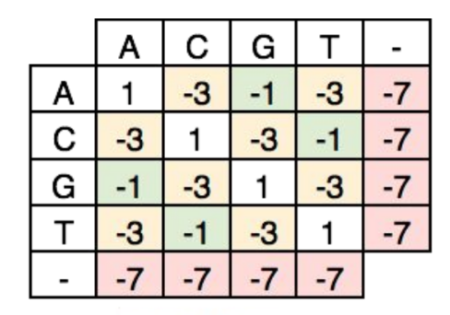
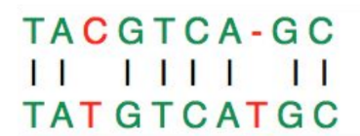
Needleman-Wunsch algorithm
global alignment technique
applications of dynamic programming for comparing biological sequences
weighted edit-distance (scoring matrix)

Slide 6
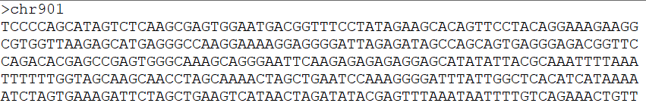
Input file formats
FASTQ – reads
FASTA – reference genome

Slide 7
Seed and Extend
1. find seed (first n characters from read) and map seed to reference
2. take rest characters from read and align it to reference (also check for read reverse complement)

Slide 8
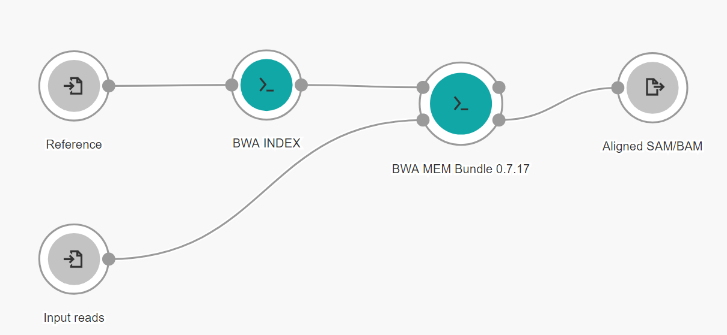
BWA MEM

Slide 9
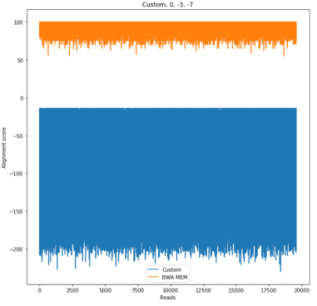
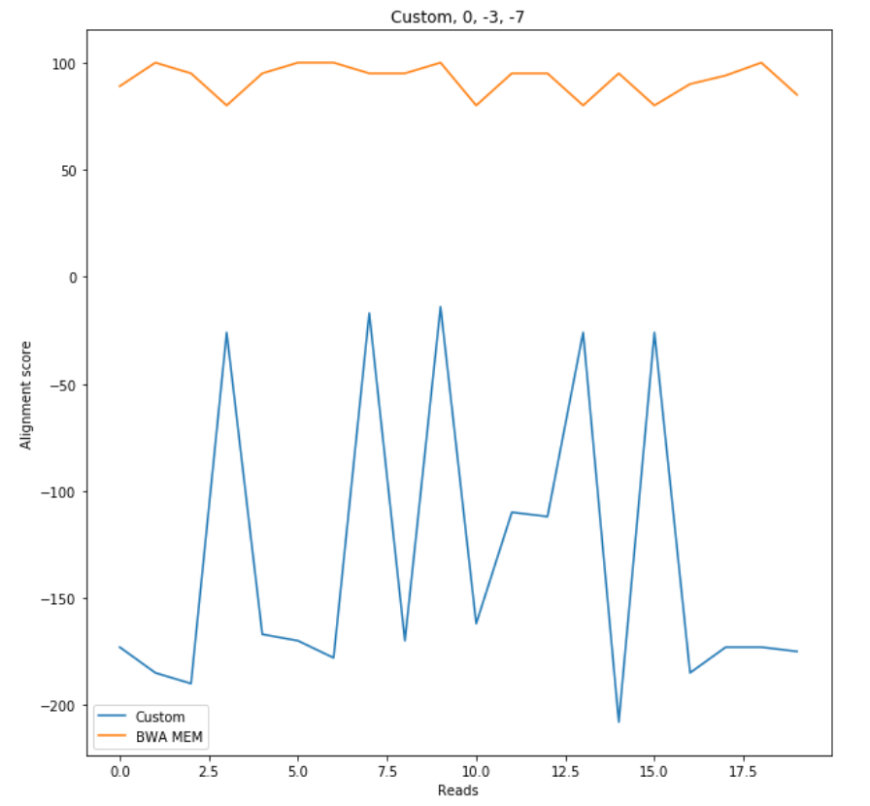
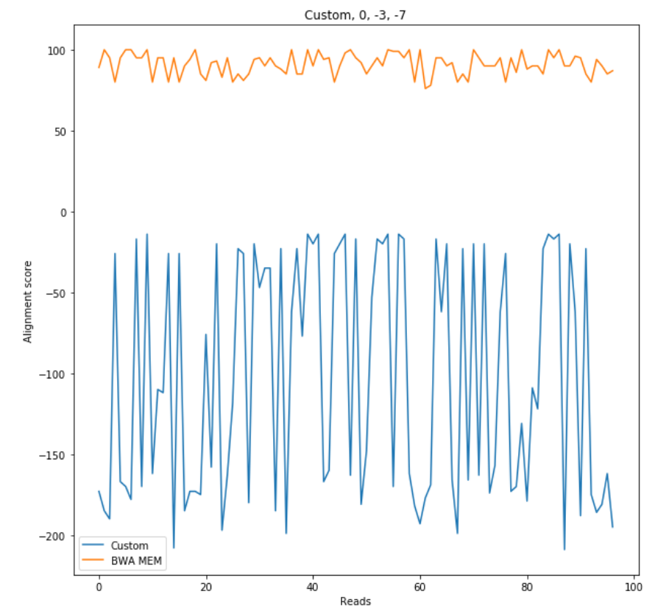
Results

Slide 10
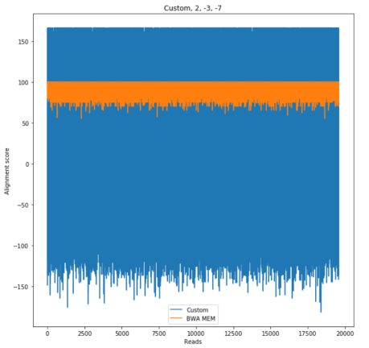
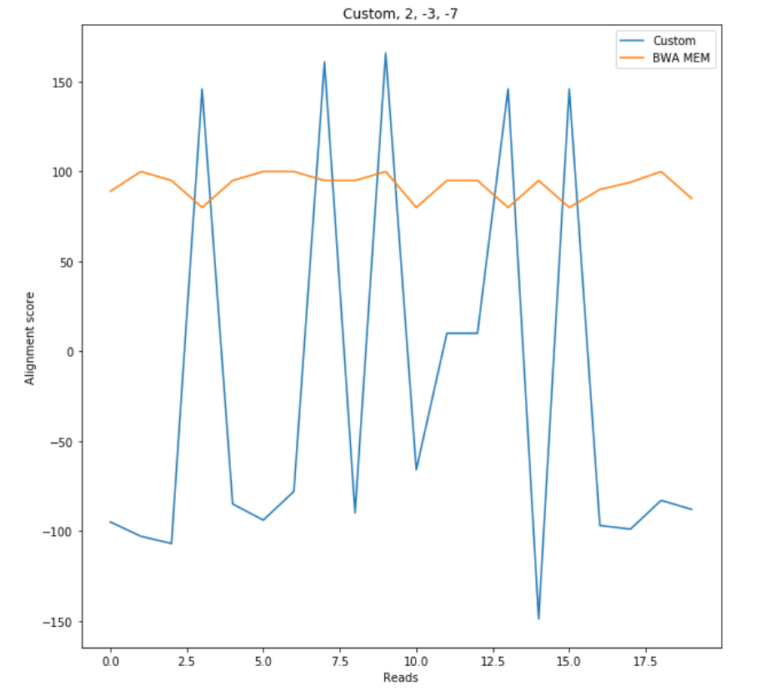
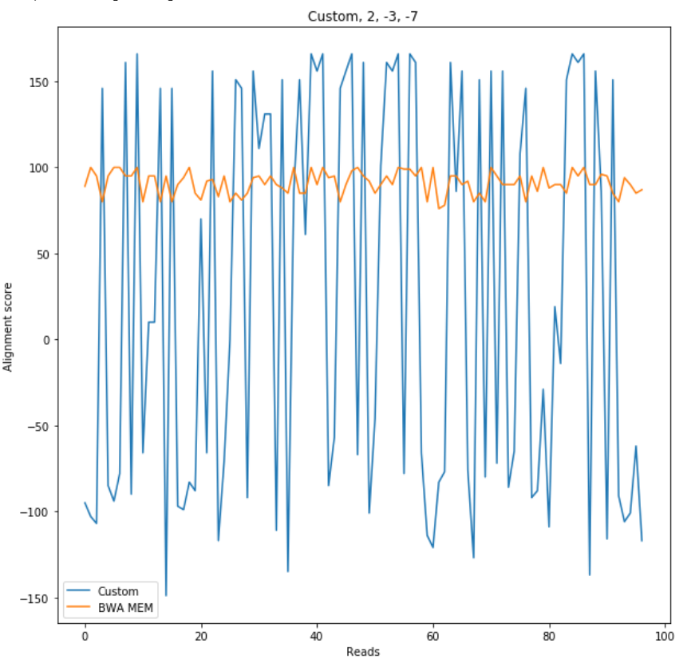
Results

Slide 11
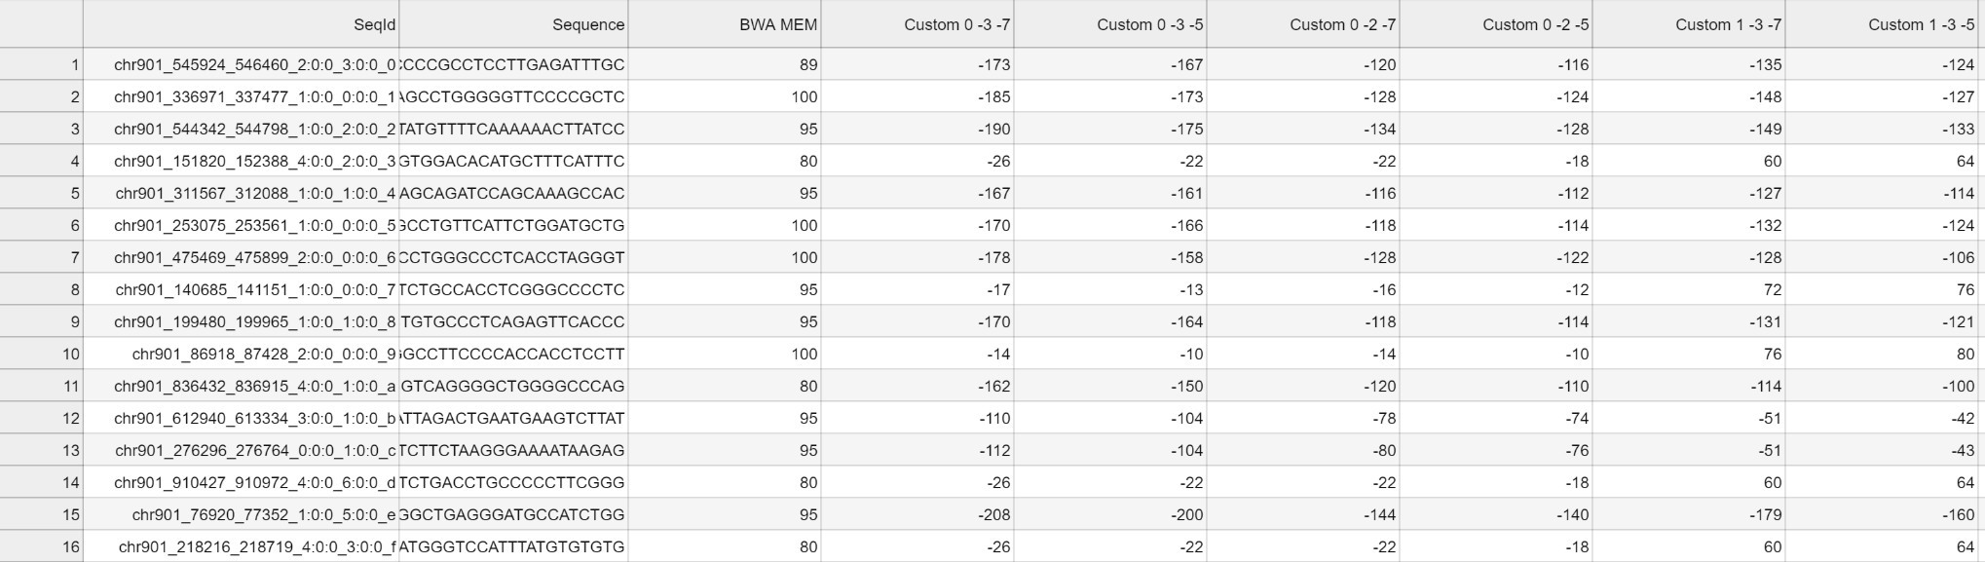
Results

Slide 12
Possible improvements
FM index – pre-calculate every ith offset in SA
try to use different algorithms for global alignment (faster or for best alignment score)

Slide 13

Thank you for your attention!
Questions?
https://github.com/s-maja/genomic-informatics

